Slide 1

Beginners guide to IOT using a Raspberry Pi
Presented By : The Assembly Team

Slide 2
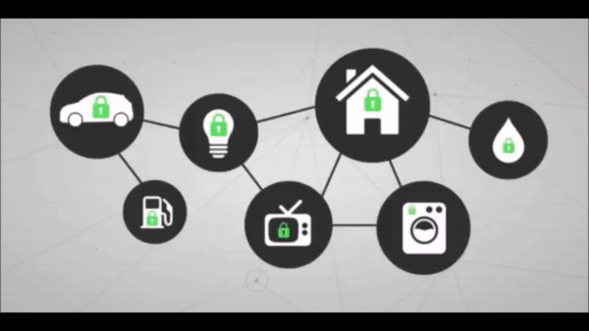
Introduction
What is Internet Of Things?
A new and emerging concept of connecting any device or appliance to the internet and therefore controlling the way they function. By having sensors embedded into these devices, they can be able to send and receive important data.
Where can this be used?
Home automations
Industrial use
Agricultural use
Healthcare

Slide 3
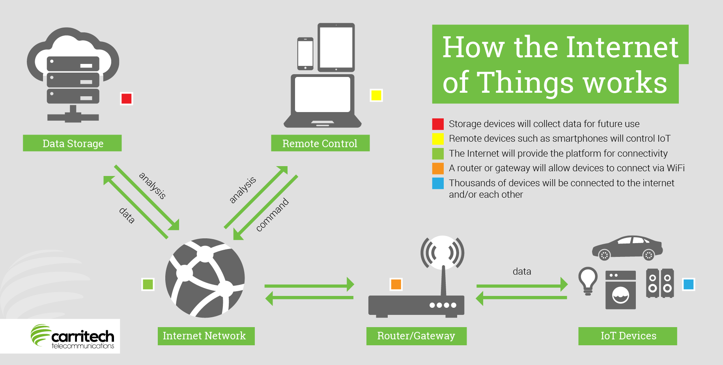
Notes:
Read More https://www.forbes.com/sites/jacobmorgan/2014/05/13/simple-explanation-internet-things-that-anyone-can-understand/#275e12b11d09

Slide 4

What we are going to do today
Data monitoring
Notifications
Controlling

Slide 5
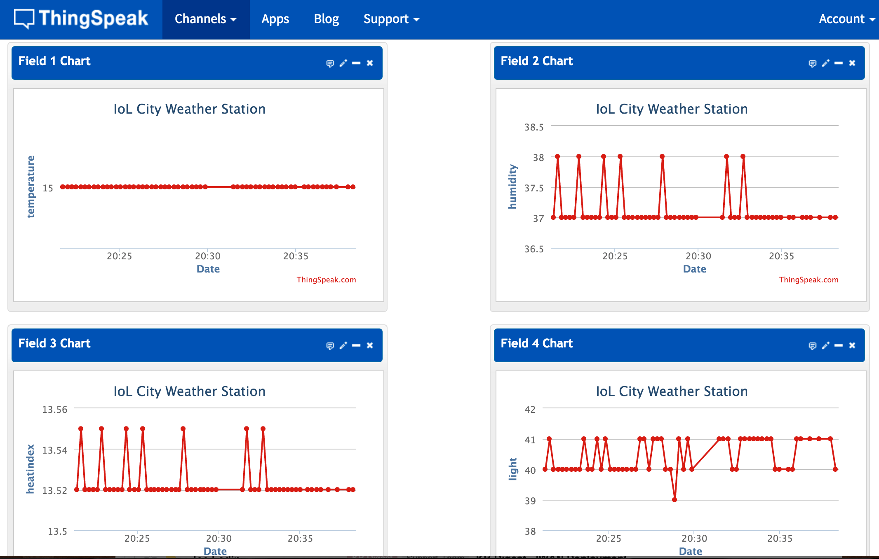
Data monitoring
Will be monitored using ThingSpeak
ThingSpeak is an online application which can be used to monitor sensor data sent through the internet and display it in a graphical format.
In this workshop, we will monitor the following parameters:
Temperature
Motions
Light
Notes:
Read More https://en.wikipedia.org/wiki/ThingSpeak

Slide 6
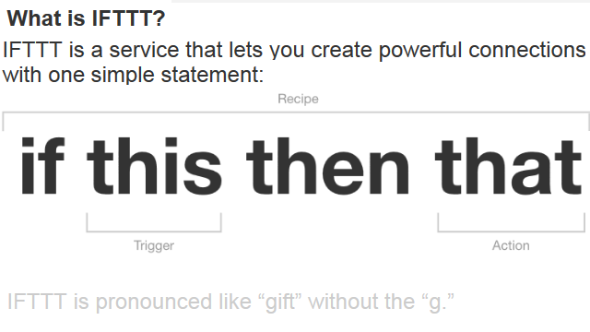
Notifications
Notifications will be triggered using IFTTT (IF This Then That)
In this workshop, we will enable notifications to be sent to our mobile devices using the IFTTT application.
We will trigger notifications for:
Detected motion
If temperature goes beyond a certain value.
If light is detected.
Notes:
Read More https://en.wikipedia.org/wiki/IFTTT

Slide 7
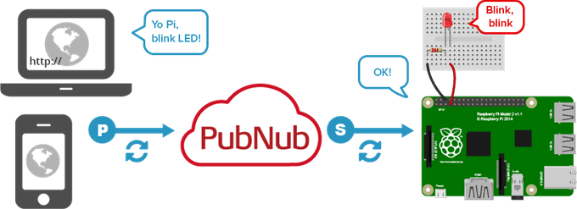
Control
Control of devices through browser can be enabled by Pubnub.
Notes:
Read More https://en.wikipedia.org/wiki/PubNub

Slide 8
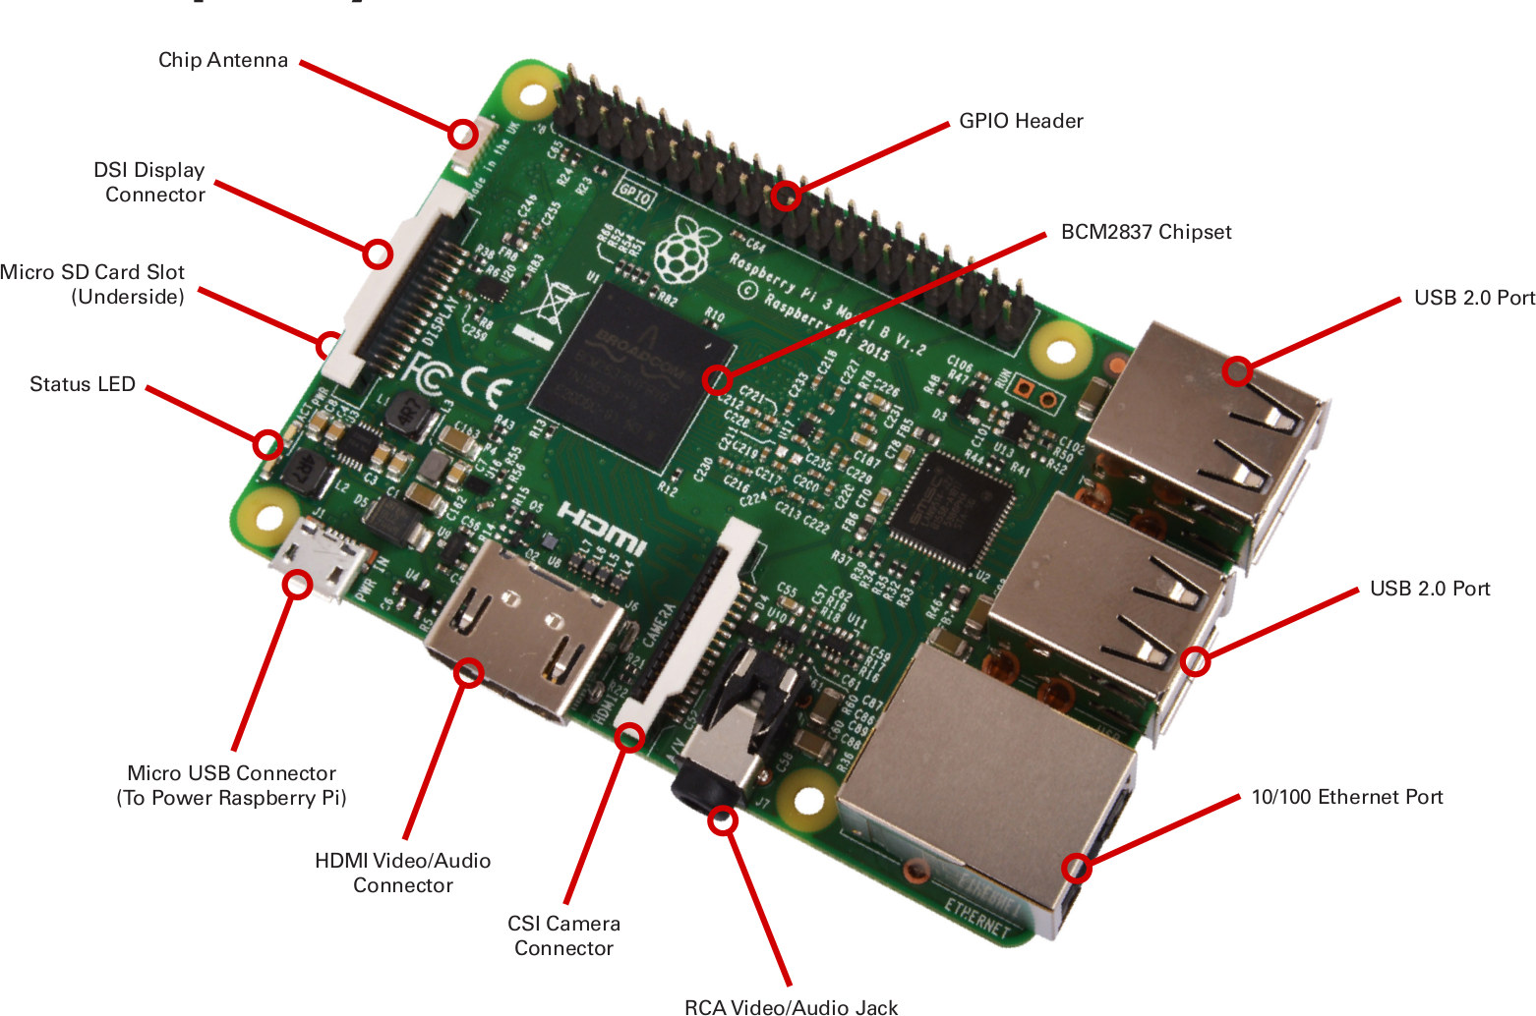
The Raspberry PI
Notes:
Main Website - https://www.raspberrypi.org/
Arduino vs Raspberry PI - https://makezine.com/2015/12/04/admittedly-simplistic-guide-raspberry-pi-vs-arduino/ ; https://circuitdigest.com/article/arduino-vs-raspberryp-pi-difference-between-the-two
Raspberry PI OS - https://lifehacker.com/the-best-operating-systems-for-your-raspberry-pi-projec-1774669829

Slide 9
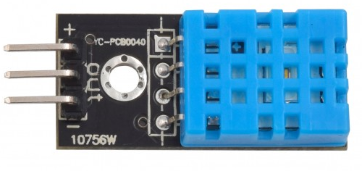
DHT11 - Temp & Humidity Sensor
Measure your surrounding air temperature and relative humidity
Capacitive humidity sensor
Thermistor for temperature sensing
Mounted 10kΩ pull up resistor
Good for 20-80% humidity readings with 5% accuracy
Good for 0-50°C temperature readings ±2°C accuracy
Notes:
Read more https://www.smart-prototyping.com/DHT11-Humidity-and-Temperature-Sensor-Module
Example with Arduino: https://www.smart-prototyping.com/blog/DHT11-Temperature-and-Humidity-Sensor-with-an-Arduino-Uno

Slide 10
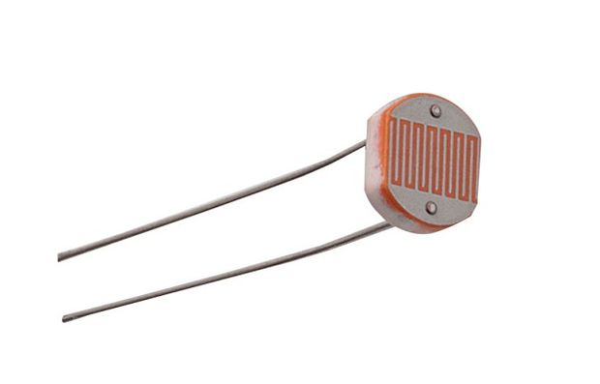
Photoresistor (LDR)
Photo resistors, also known as light dependent resistors (LDR)
Measures the light intensity
In the dark, their resistance is very high, and when exposed to light, the resistance drops dramatically
Variable resistor which varies depending on the intensity of light that fall upon it
Notes:
Read more http://www.resistorguide.com/photoresistor/
https://www.kitronik.co.uk/blog/how-an-ldr-light-dependent-resistor-works/

Slide 11
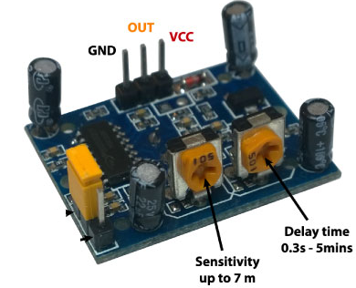
PIR motion sensor
Pyroelectric/ Passive infrared motion sensor
Detect movements/ motion whenever an object in detected in the sensor range
Made up of pyroelectric sensor (round dome), detects levels of infrared radiation.
2 knobs to provide control for the device
Notes:
Read more https://learn.adafruit.com/pir-passive-infrared-proximity-motion-sensor/how-pirs-work

Slide 12
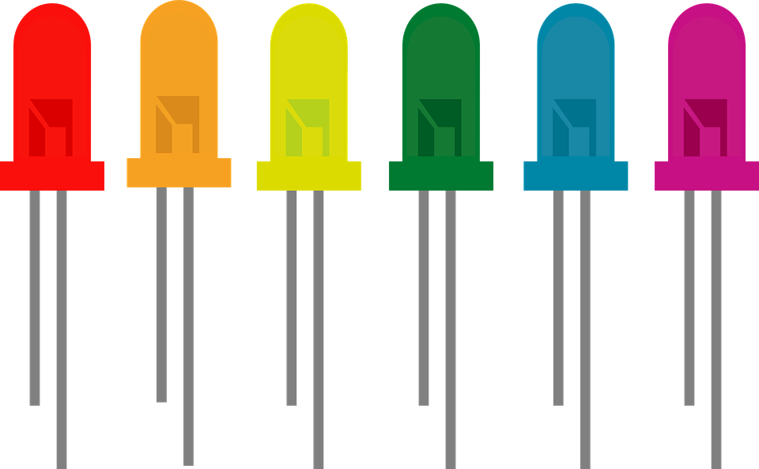

Light Emitted Diode
Light Emitting Diode (LED)
Semi-conductor device
A particular type of diode that convert electrical energy into light.
LEDs are like tiny lightbulbs (require less power)
Energy efficient in comparison
Longer end -> positive end (anode)
Shorter end -> negative end (cathode)
Notes:
*A semiconductor is a substance, usually a solid chemical element or compound, that can conduct electricity under some
conditions but not others, making it a good medium for the control of electrical current.
*The key function of an ideal diode is to control the direction of current-flow. Current passing through a diode can only go in
one direction, called the forward direction.
Read more https://learn.sparkfun.com/tutorials/light-emitting-diodes-leds
http://whatis.techtarget.com/definition/light-emitting-diode-LED

Slide 13

Let’s Begin

Slide 14
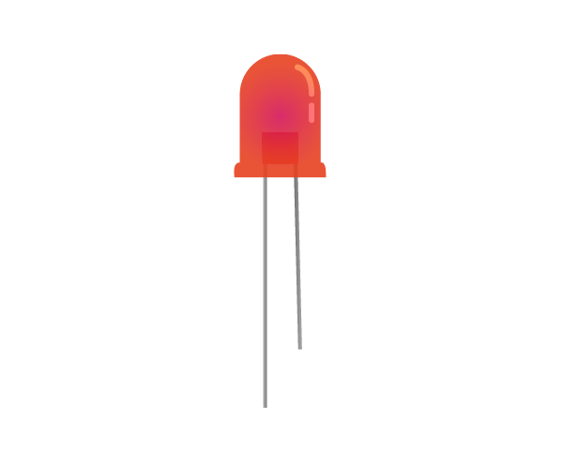


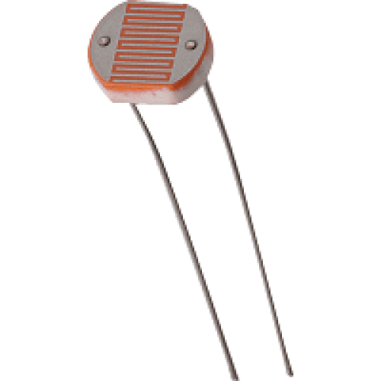
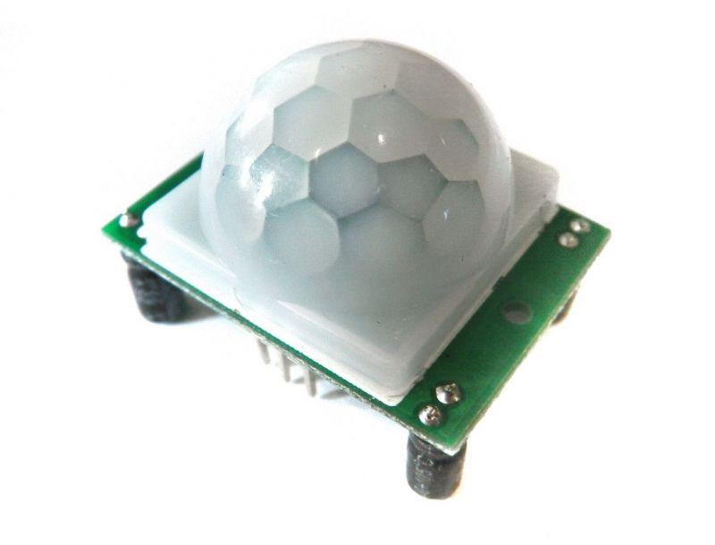
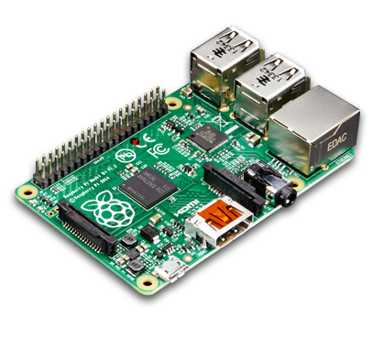
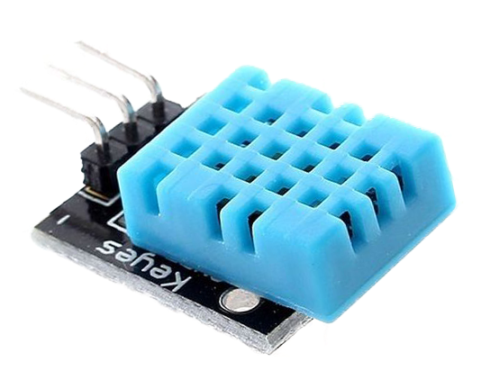

What will we be building

Slide 15
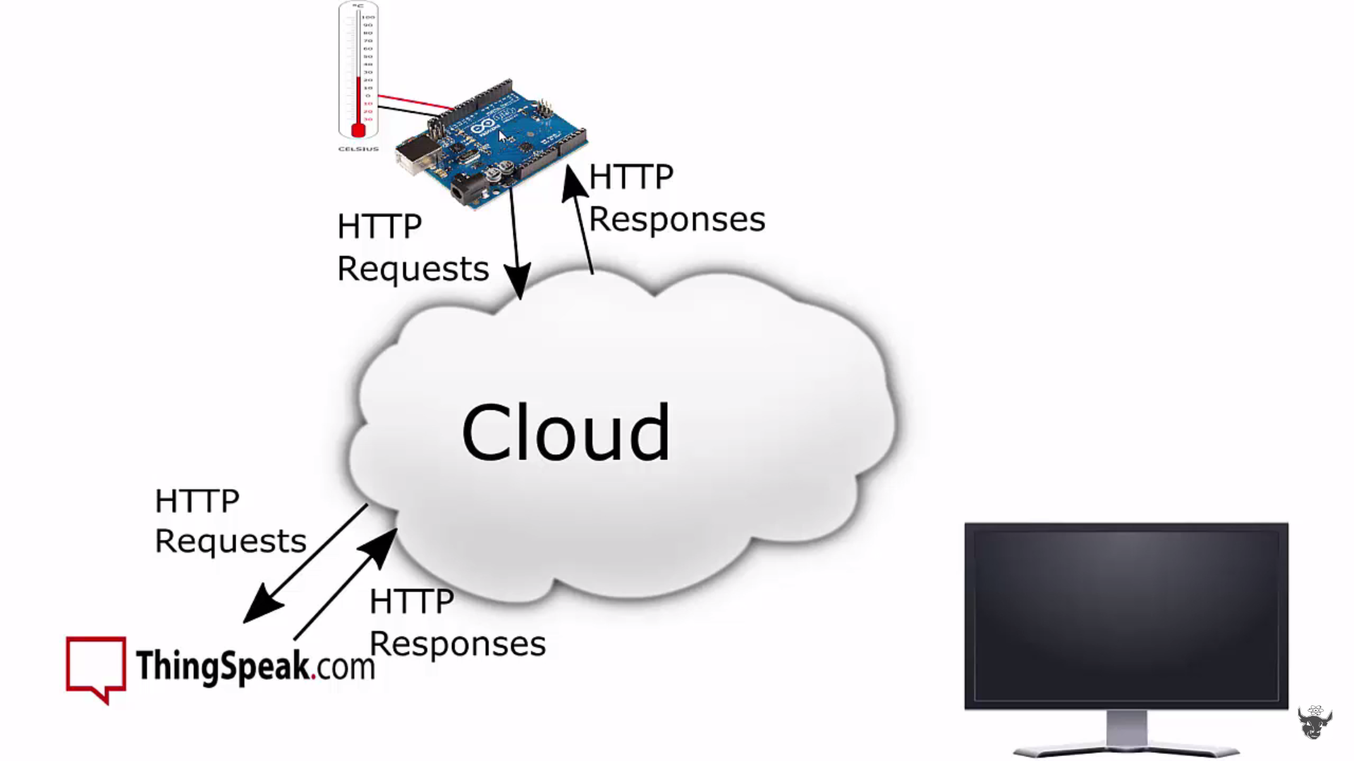
Overview of the Process

Slide 16
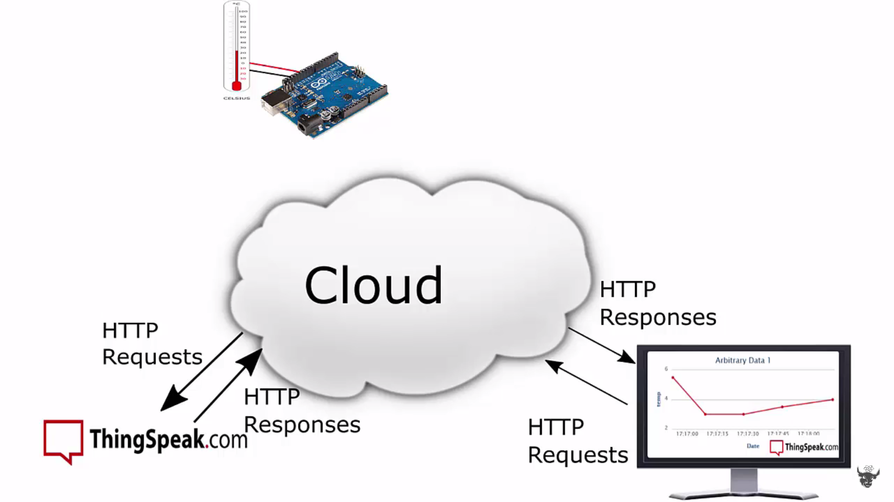
Overview of the Process

Slide 17
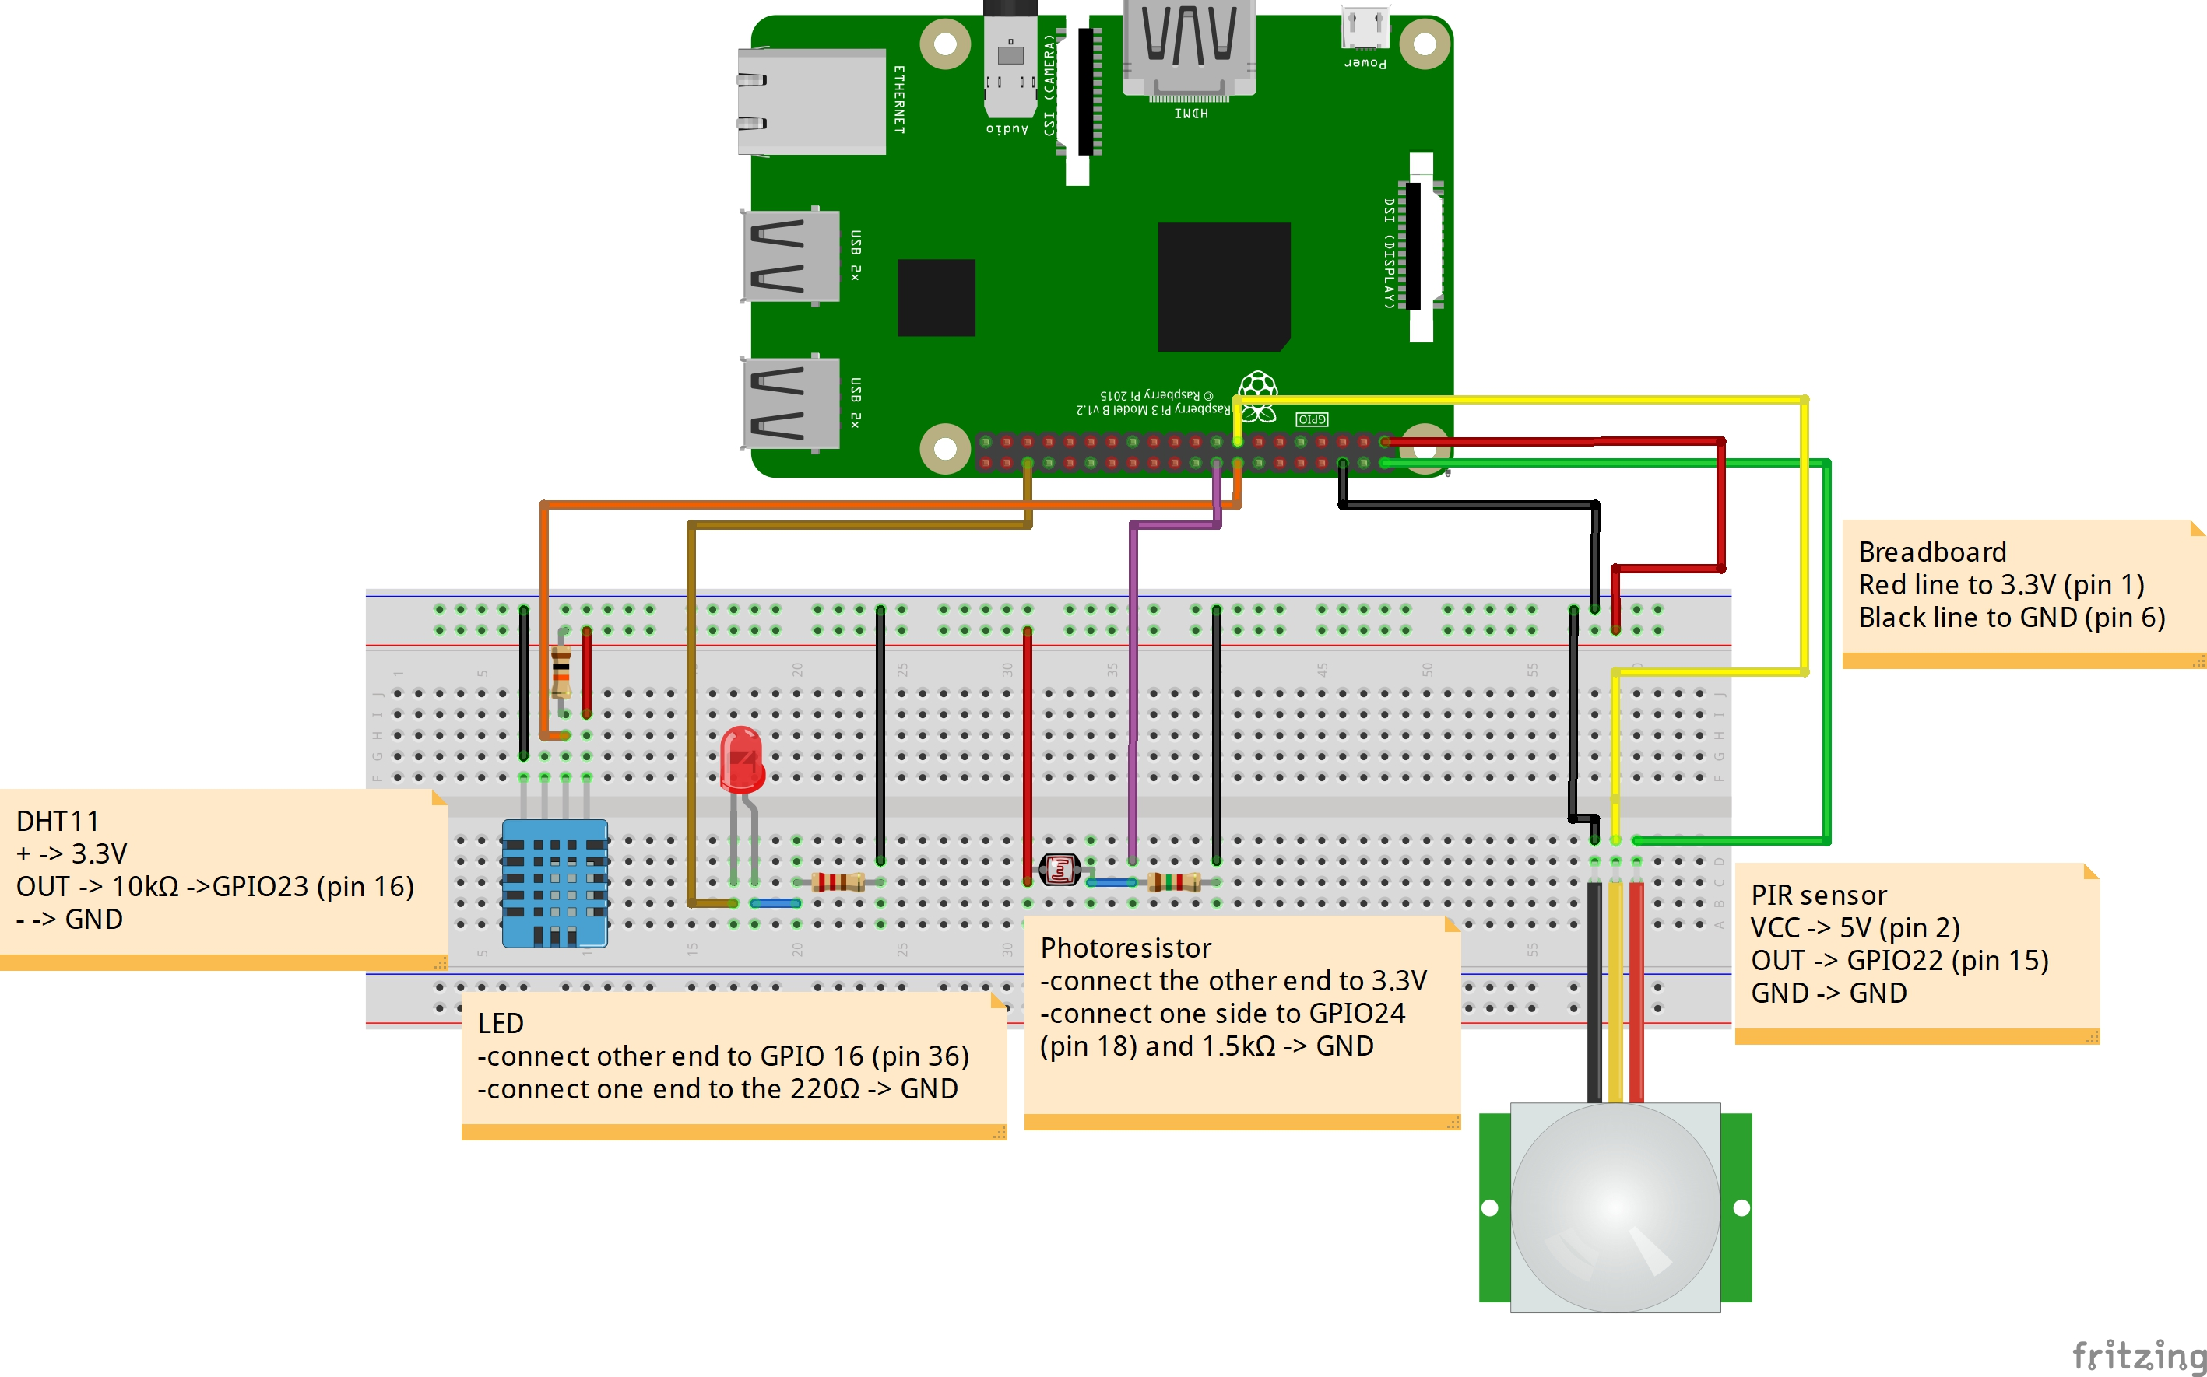
The Circuit Diagram

Slide 18
Code and steps
You can find the code and the steps on how to carry with the entire workshop on:
https://github.com/The-Assembly/IOT-using-raspberry-PI

Slide 19

THANK YOU
THANK YOU

